Slide 1
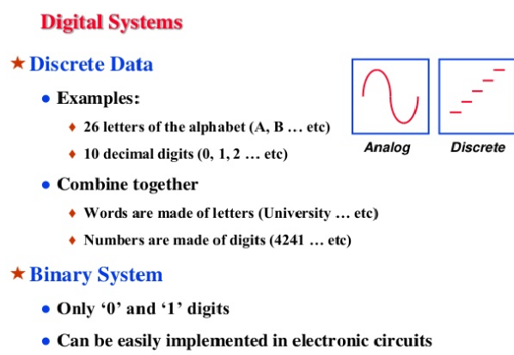

Slide 2
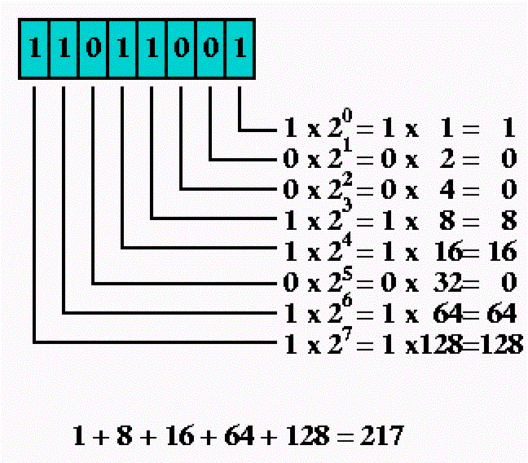
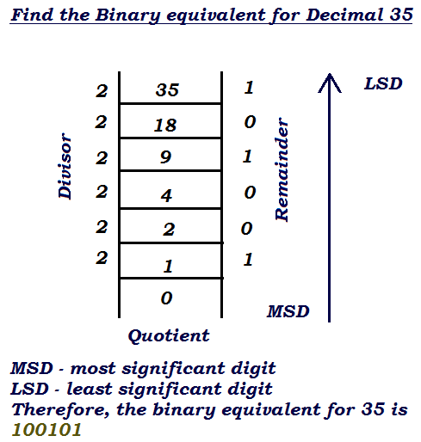
Decimal Numbers:
Human beings are trained to understand the decimal number system.
Eg: 1327=1×1000 +3×100+2×10+7×1
Binary Numbers:
Digital computers use binary numbers.
It uses only digits 0 and 1called bits.
Binary to decimal :
Decimal to binary:

Slide 3
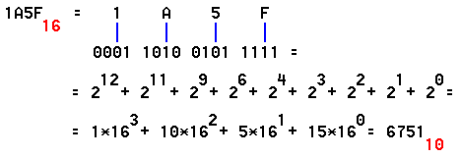
Hexadecimal system (0-15), in the powers of 16.
Same from 0-9 as decimal
Remember A = 10, (1010)₂
B = 11, (1011)₂
C = 12, (1100)₂
D = 13, (1101)₂
E = 14, (1110)₂
F = 15, (1111)₂
Hexadecimal to binary

Slide 4
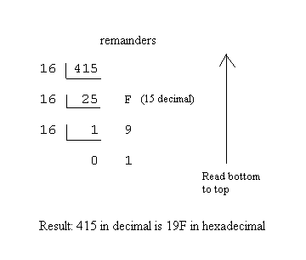
Decimal to Hexadecimal:

Slide 5
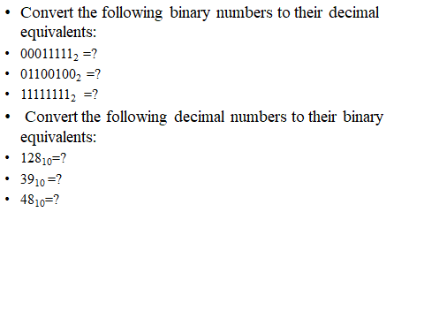
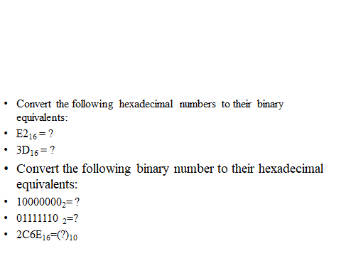
Practice Examples:

Slide 6
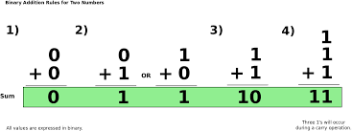
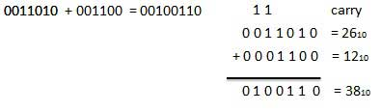
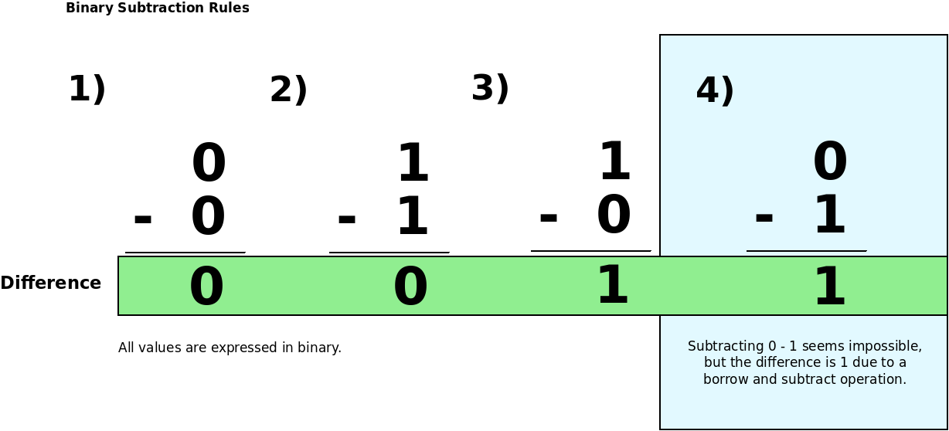
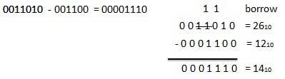
Binary Arithmetic:
Binary Addition
Binary Addition Example:
Binary Subtraction:
Binary Subtraction Example:

Slide 7
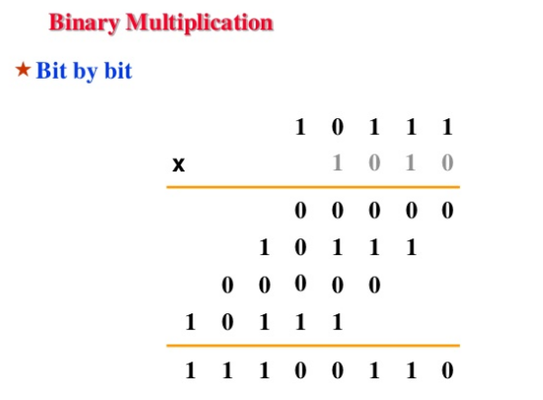

Slide 8
One’s and Twos Compliments
The one’s complement of a binary number is defined as the value obtained by inverting all the bits in the binary representation of the number (swapping 0s for 1s and vice versa). The ones' complement of the number then behaves like the negative of the original number in some arithmetic operations.
Example: 10010110000 01101001111
Two’s compliments are generally used to represents negative integers in almost all computers. To get the two's complement negative notation of an integer, you write out the number in binary. You then invert the digits, and add one to the result.
Example:
10010110000 01101001111
01101001111 + 1 01101010000
1:Translate the following signed decimal numbers to their 2s compliment form:
-10 (b) -21 (c) -34 (d) -96
2:Translate the following 2s compliment notations to their signed decimal equivalents: (a) 11111011 (b) 00001111 (c) 10001111 (d) 01110111

Slide 9
1(a):11110110 (b)11101011 (c)11011110 (d)10100000
2(a): -5 (b) +15 (c) -113 (d) +119

Slide 10
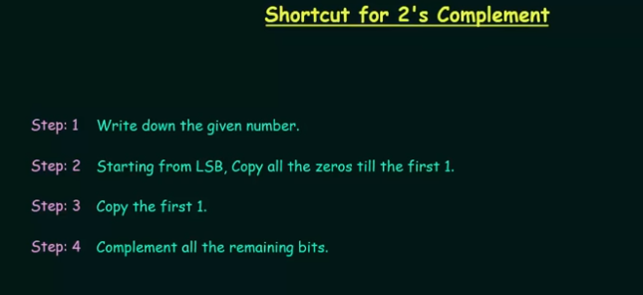

Slide 11
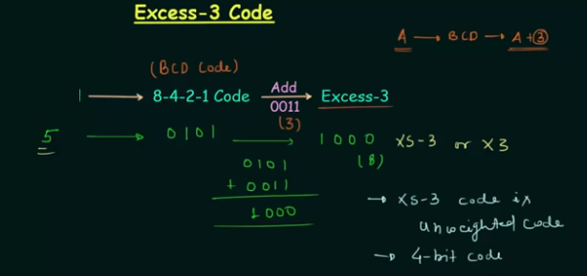
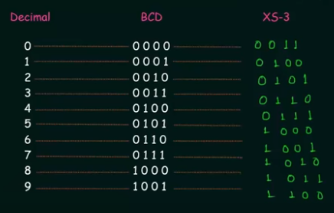

Slide 14
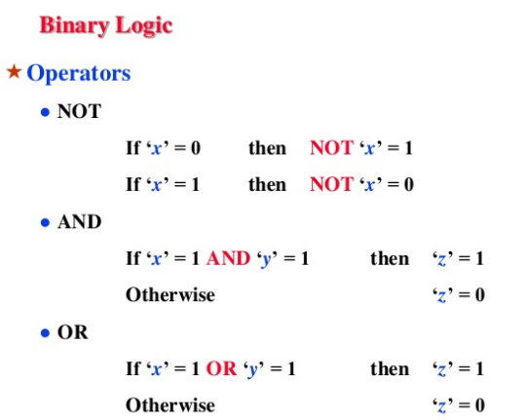

Slide 15
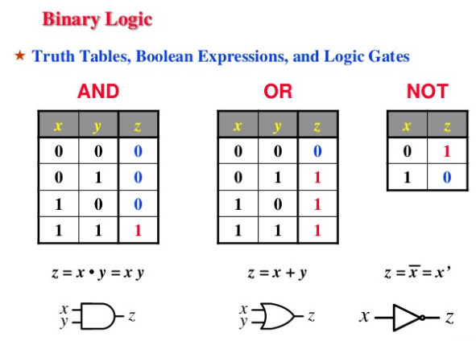

Slide 16
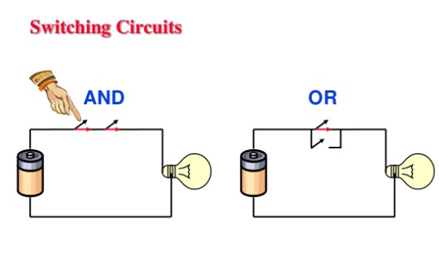

Slide 17
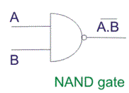
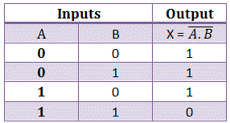
NAND gate as Universal Gate
The below diagram is of a two input NAND gate. The first part is an AND gate and second part is a dot after it represents a NOT gate. So it is clear that during the operation of NAND gate, the inputs are first going through AND gate and after that the output is reversed and we get the final output. Now we will look at the truth table of NAND gate.
We will consider the truth table of the NAND gate i.e. a two-input gate. The two inputs are A and B.

Slide 18
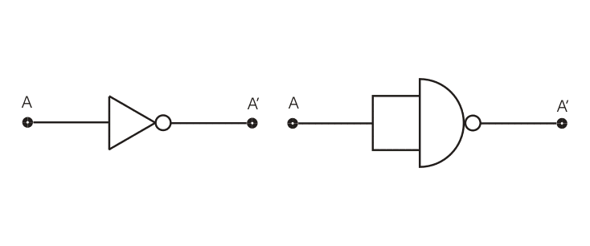
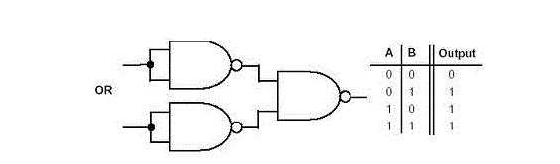
Now we will see how this gate can be used to make other gates.
The below diagram is of an OR gate made from combinations of NAND gates, arranged in a proper manner. The truth table of an OR gate is also given beside the diagram.

Slide 19
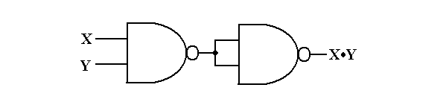
Now we will see the design of an AND gate from NAND gates.
The above diagram is of an AND gate made from NAND gate. So we can see that all the three basic gates can be made by only using NAND gates, that’s why this gate is called Universal Gate and it is appropriate.

Slide 20

NOR gate as universal gate
We have seen how NAND gate can be used to make all the three basic gates by using that alone. Now we will discuss the same in case of NOR gate.
The above diagram is of an OR gate made by only using NOR gates. The output of this gate is exactly similar to that of a single OR gate. As we can see the circuit arrangement of OR gate using NOR gates is similar to that of AND gate using NAND gates.

Slide 21
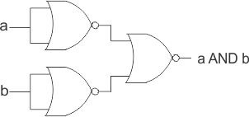

The above diagram as the name suggests is of AND gate using only NOR gate, again we can see that the circuit diagram of AND gate using only NOR gate is exactly similar to that of OR gate using only NAND gates. Now we will finally see how a NOT gate can be made by using only NOR gates.
The above diagram is of a NOT gate made by using a NOR gate. The circuit diagram is similar to that of NOT gate made by using only NAND gate. So, from the above discussion it is clear that all the three basic gates (AND, OR, NOT) can be made by only using NOR gate. And thus, it can be aptly termed as Universal Gate.

Slide 22
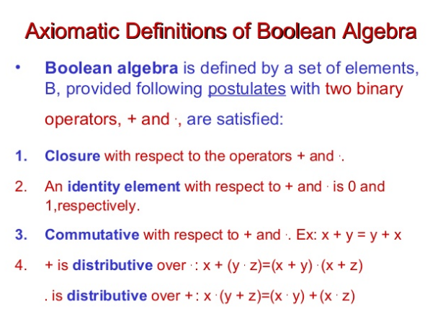

Slide 23
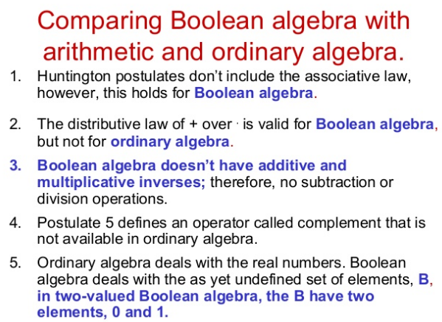

Slide 24
